Slide 1
A Comparative Study of Classical and Transformer-Based Models for Phishing Email Detection
Student: João Bernardo SOUSA FARIA
Student ID: 0232421751
Supervisor: Salima LAMSIYAH
Bachelor Semester Project 6

Slide 2
Why Phishing Email Detection?
Phishing emails are a common cybersecurity threat
They try to trick users into clicking links or revealing sensitive information
Automatic detection can help identify dangerous emails earlier

Slide 3
Research Objective
Scientific Question: How do classical feature-based models compare with transformer-based models for phishing email detection?
Classical model: TF-IDF + Logistic Regression
Transformer model: fine-tuned BERT
Focus: performance, interpretability, and generalization

Slide 4
Dataset
Primary dataset:
zefang-liu/phishing-email-dataset
17,537 emails after preprocessing
10,979 safe / 6,558 phishing
label = 0: Safe email
label = 1: Phishing email
Second dataset:
DIFraud phishing benchmark
Used for cross-dataset generalization

Slide 5
Dataset | Rows | Number of safe emails | Number of phishing emails | Phishing Percentage | Average Text Length
zefang-liu/phishing-email-dataset | 17537 | 10979 | 6558 | 37.40 | 2861.99
difraud/difraud phishing | 15272 | 9198 | 6074 | 39.77 | 2260.79

Slide 6
Preprocessing
Raw Emails
Removal of missing values
Map labels to 0/1
Removal of Duplicates
Stratified Splits
(train, dev, test)

Slide 7
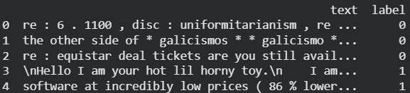
Example Emails and Labels

Slide 8
Models (Comparison)
TF-IDF + Logistic Regression
Fast
Simple
Interpretable
Coefficients can be inspected
BERT
Contextual language model
Understands word context
Higher computational cost
Less directly interpretable
Zero-shot NLI (Natural Language Inference)
• No phishing-specific training
• Uses label hypotheses
• Evaluated on 200-email subset
• Exploratory baseline

Slide 9
Threshold Tuning
Default threshold: 0.50
Optimized threshold: selected on the validation set for each model
Goal: maximize phishing F1-score

Slide 10
Evaluation Metrics
Accuracy (overall percentage of correct predictions)
Phishing precision (how many predicted phishing emails were truly phishing)
Phishing recall (how many real phishing emails were detected)
Phishing F1-score (balance between phishing precision and recall)
Macro-F1 (average F1 of both classes equally)
Micro-F1 (overall F1 across all predictions)
Weighted-F1 (average F1 weighted by the number of examples in each class)

Slide 11
Main Results
Model | Threshold | Accuracy | Phishing Precision | Phishing Recall | Phishing F1-score | Macro F1-score | Micro F1-score | Weighted F1-score
TF-IDF + Logistic Regression | 0.45 | 0.9814 | 0.9708 | 0.9797 | 0.9752 | 0.9801 | 0.9814 | 0.9814
TF-IDF + Logistic Regression (balanced) | 0.54 | 0.9814 | 0.9698 | 0.9807 | 0.9752 | 0.9802 | 0.9814 | 0.9814
BERT | 0.08 | 0.9875 | 0.9847 | 0.9817 | 0.9832 | 0.9866 | 0.9875 | 0.9875
Zero-shot NLI | N/A | 0.6200 | 0.4615 | 0.0800 | 0.1364 | 0.4464 | 0.6200 | 0.5239
Note: Zero-shot NLI was evaluated on a stratified subset of 200 test emails due to its higher computational cost.

Slide 12
Explainability/Error Analysis
Logistic Regression coefficients show which words push predictions toward phishing or safe
Some phishing emails look professional or technical
Some safe emails contain suspicious-looking links or formatting
This shows phishing detection is not only keyword matching

Slide 13
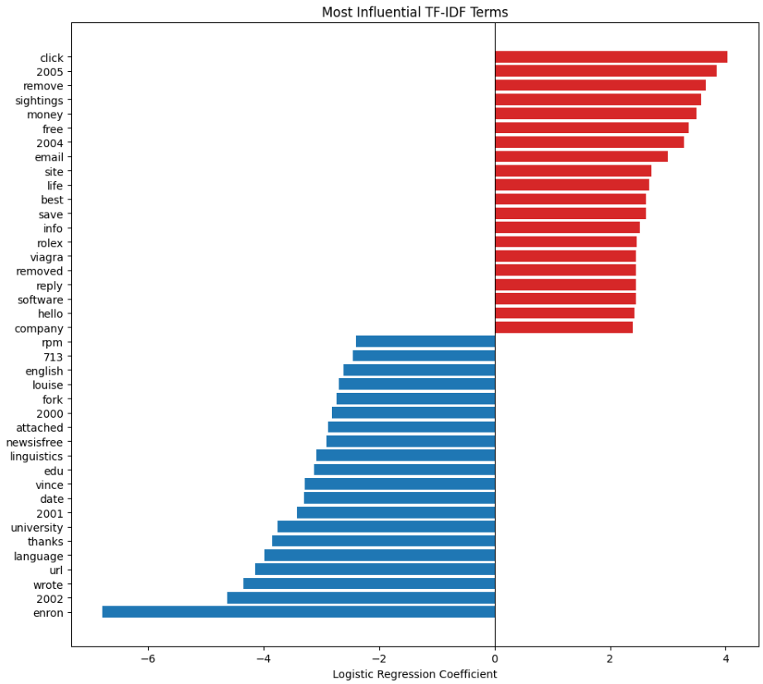
Logistic Regression Explainability
Positive coefficients: pushing the prediction toward the "phishing" category
Negative coefficients: pushing the prediction toward the "safe" category
Makes the classical model easier to interpret than BERT

Slide 14
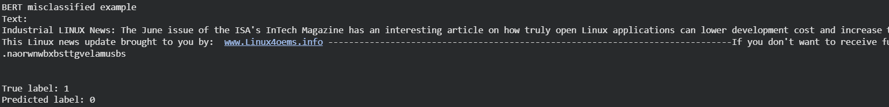
Examples of Misclassified Emails

Slide 15
Cross-Dataset Generalization
Experiment | Accuracy | Phishing Precision | Phishing Recall | Phishing F1-score | Macro F1-score | Micro F1-score | Weighted F1-score
Primary train + test | 0.9814 | 0.9708 | 0.9797 | 0.9752 | 0.9801 | 0.9814 | 0.9814
Difraud train + test | 0.9719 | 0.9879 | 0.9408 | 0.9638 | 0.9704 | 0.9719 | 0.9717
Primary trained -> Difraud test | 0.9051 | 0.8360 | 0.9474 | 0.8882 | 0.9029 | 0.9051 | 0.9059
Difraud trained -> Primary test | 0.7948 | 0.9703 | 0.4654 | 0.6291 | 0.7436 | 0.7948 | 0.7725

Slide 16
Limitations and Future Work
BERT used max length 128 tokens
Only one transformer model was fine-tuned
Public phishing datasets may contain noisy labels
Zero-shot NLI was evaluated on a 200-email stratified subset, but performed much worse than the trained models
Test RoBERTa, DistilBERT, or long-context models
Train on mixed datasets
Add BERT explainability methods
Evaluate deployment metrics such as latency and false negatives

Slide 17
Conclusion
BERT achieved the best final performance
TF-IDF + Logistic Regression remained highly competitive
Zero-shot NLI was not competitive with the trained models
Classical models are useful when speed and interpretability matter
Cross-dataset testing showed that generalization remains a challenge

Slide 18
Thank you for your attention!

